Slide 1
CSE 417T Introduction to Machine Learning
Review of Exam 2 Instructor: Chien-Ju (CJ) Ho

Slide 2
Logistics: Exam 2
Exam 2 Date: December 8, 2022 (Thursday)
In-class exam (the same time/location as the lecture)
Exam duration: 75 minutes
Content
Focus on the content of 2nd half of the semester
However, knowledge is cumulative, and you are still expected to know the concepts earlier
2 sections of questions
4~6 long questions (written response questions with explanations required)
10 multiple choice questions (no explanations needed)
Closed-book exam. You can bring two cheat-sheets
Up to letter size, front and back (up to 4 pages)
No format limitations (it can be typed, written, or a combination)
No calculators (you don’t need them)

Slide 3
Logistics: Exam Policies
Similar to Exam 1, I might arrange random seat assignments
Will be announced on Piazza the night before the exam if I do
If you prefer a left-handed seat, input your id on the following form:
https://forms.gle/23247jWkqWmSSj8r7
Please submit by Wednesday noon
The same form as in Exam 1
If you have done so in Exam 1, no need to do it again
The link is on a pinned Piazza post

Slide 4
Logistics: Exam Policies
Please arrive on time. No extensions will be given if you arrive late.
During the exam, if you have a question or if you finish before time is up:
Do not get up
Raise your hand and I will come to you
I most likely will not answer questions to individual students
But I’ll give clarifications to everyone if multiple students ask the same question
When time is called:
Stop writing
Do not get up
We will come around and collect your exam

Slide 5
Homework
Solution Sketch of HW5 has been posted on Gradescope
Not intended to be comprehensive

Slide 6
Plans for Today
Brief review of course content.
Discussion of the practice questions.
Discussion of any other questions you might have.

Slide 7
Brief Review
A quick review brushed over what we talked about.
Not guaranteed (and not likely) to cover everything in the exam.

Slide 8
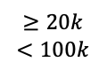
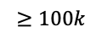
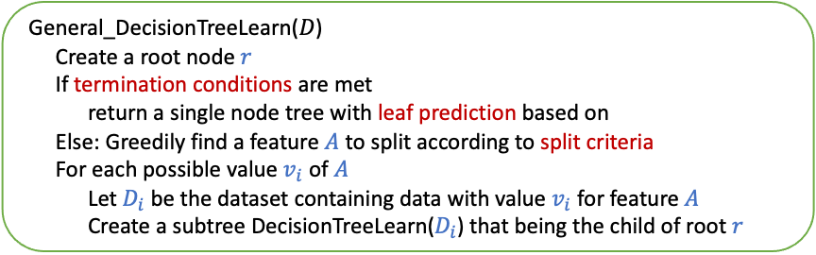
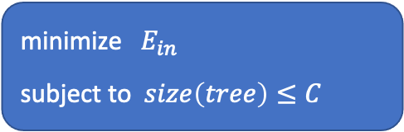
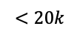
Decision Tree Hypothesis
Pros
Easy to interpret, handle multi-type data, easy to implement
Cons
bad generalization
VC dimension is infinity, high variance, easily overfit
Why we care?
One of the classical model
Building block for other models (e.g., random forest)
Annual Income
$$≥100k$$
$$≥20k$$
$$<100k$$
$$<20k$$
Approve
have debt?
Deny
Deny
yes
no
Deny
Deny
Approve
Approve
Decision tree learning:
General_DecisionTreeLearn($D$)
Create a root node $r$
If termination conditions are met
return a single node tree with leaf prediction based on
Else: Greedily find a feature $A$ to split according to split criteria
For each possible value $v_{i}$ of $A$
Let $D_{i}$ be the dataset containing data with value $v_{i}$ for feature $A$
Create a subtree DecisionTreeLearn($D_{i}$) that being the child of root $r$
minimize $E_{in}$
subject to $size\left(tree\right)≤C$
approximately
Goal:

Slide 9
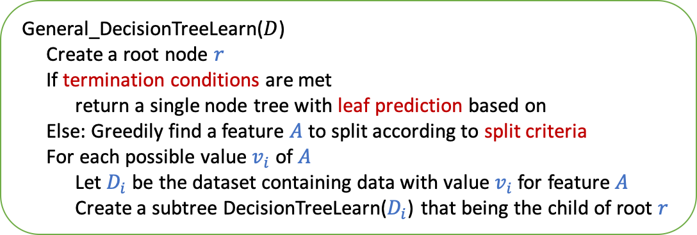
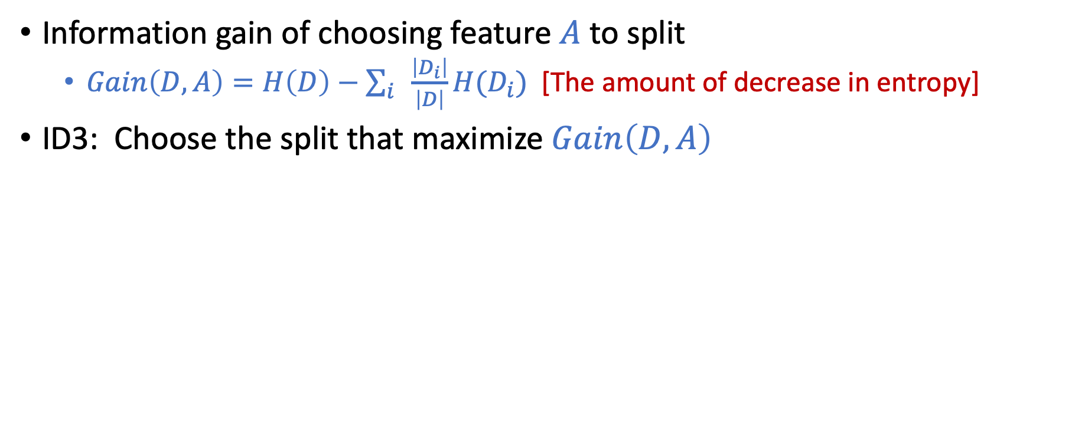
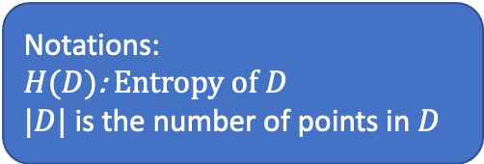
ID3: Using Information Gain as Selection Criteria
Information gain of choosing feature $A$ to split
$Gain\left(D,A\right)=H\left(D\right)−\sum_{i}{\frac{\left|D_{i}\right|}{\left|D\right|}}H(D_{i})$ [The amount of decrease in entropy]
ID3: Choose the split that maximize $Gain\left(D,A\right)$
Notations:
$H(D)$: Entropy of $D$
$|D|$ is the number of points in $D$
General_DecisionTreeLearn($D$)
Create a root node $r$
If termination conditions are met
return a single node tree with leaf prediction based on
Else: Greedily find a feature $A$ to split according to split criteria
For each possible value $v_{i}$ of $A$
Let $D_{i}$ be the dataset containing data with value $v_{i}$ for feature $A$
Create a subtree DecisionTreeLearn($D_{i}$) that being the child of root $r$
ID3 termination conditions
If all labels are the same
If all features are the same
If dataset is empty
ID3 leaf predictions
Most common labels (majority voting)
ID3 split criteria
Information gain

Slide 10
Ensemble Learning
Goal: Utilize a set of weak learners to obtain a strong learner.
Format of ensemble learning
Construct many diverse weak learners
Aggregate the weak learners
Bagging:
Construct diverse weak learners
(Simultaneously) bootstrapping datasets
Train weak learners on them
Aggregate the weak learners
Uniform aggregation
Boosting
Construct diverse weak learners
Adaptively generating datasets
Train weak learners on them
Aggregate the weak learners
Weighted aggregation
Weak learner choice:
Fully-grown decision trees (low bias, high variance)
Decision stumps (high bias, low variance)

Slide 11
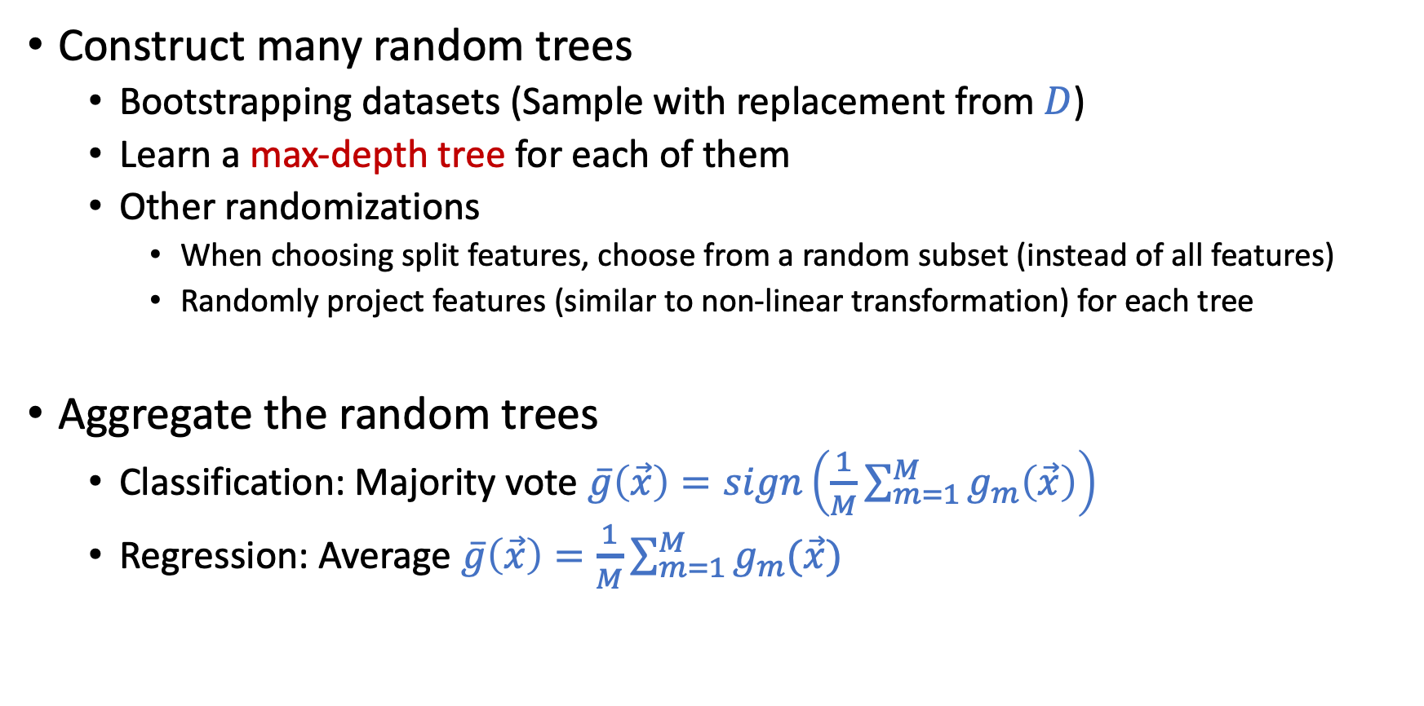
Bagging and Random Forest
Construct many random trees
Bootstrapping datasets (Sample with replacement from $D$)
Learn a max-depth tree for each of them
Other randomizations
When choosing split features, choose from a random subset (instead of all features)
Randomly project features (similar to non-linear transformation) for each tree
Aggregate the random trees
Classification: Majority vote $\overline{g}\left(\vec{x}\right)=sign\left(\frac{1}{M}\sum_{m=1}^{M}{g_{m}\left(\vec{x}\right)}\right)$
Regression: Average $\overline{g}\left(\vec{x}\right)=\frac{1}{M}\sum_{m=1}^{M}{g_{m}(\vec{x})}$

Slide 12
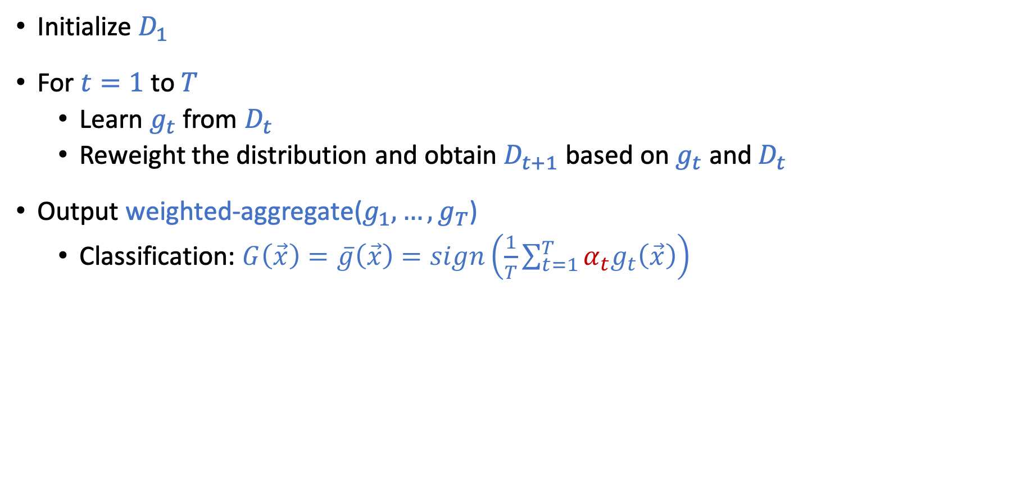
Outline of a Boosting Algorithm
Initialize $D_{1}$
For $t=1$ to$T$
Learn $g_{t}$ from $D_{t}$
Reweight the distribution and obtain $D_{t+1}$ based on $g_{t}$ and $D_{t}$
Output weighted-aggregate($g_{1},…,g_{T}$)
Classification: $G\left(\vec{x}\right)=\overline{g}\left(\vec{x}\right)=sign\left(\frac{1}{T}\sum_{t=1}^{T}{α_{t}g_{t}\left(\vec{x}\right)}\right)$
Questions
How to learn $g_{t}$ from $D_{t}$
How to reweight the distribution and obtain $D_{t+1}$
How to perform weighted aggregation

Slide 13
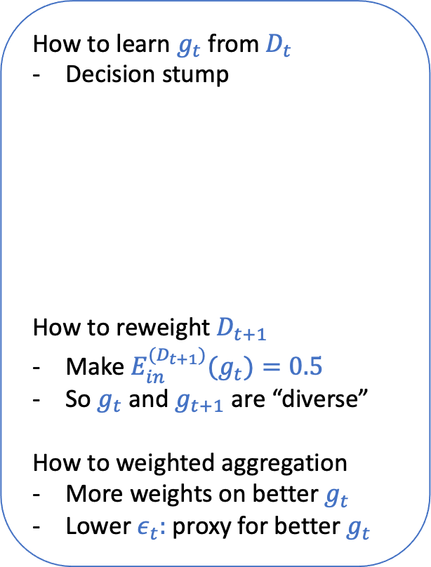
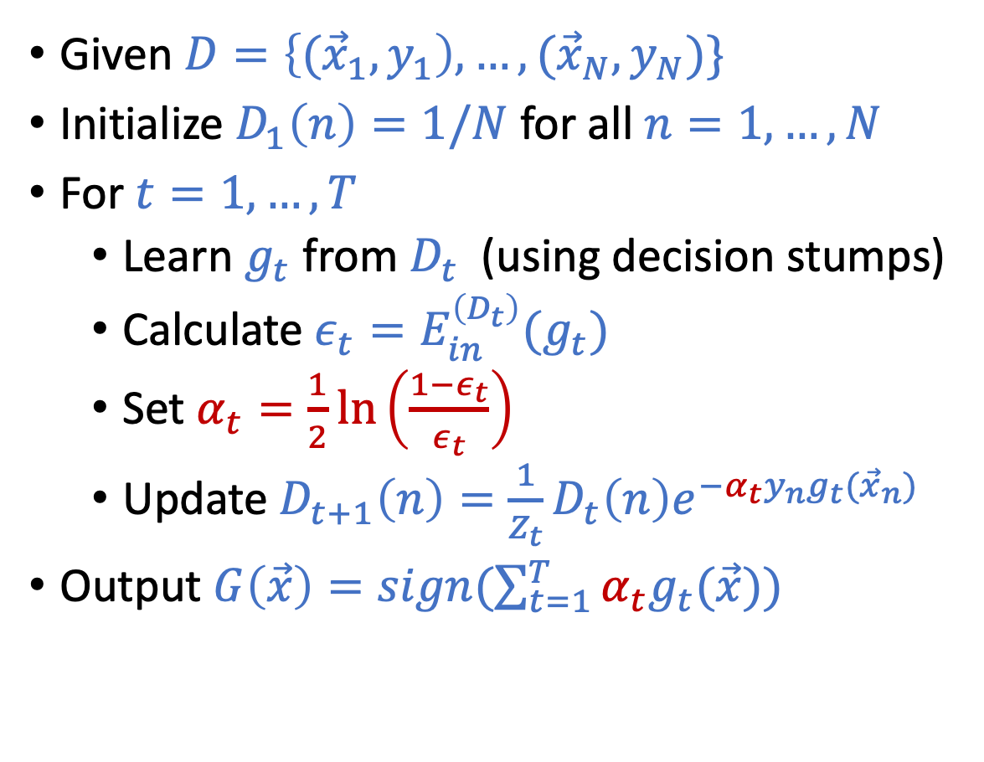
AdaBoost Algorithm
How to learn $g_{t}$ from $D_{t}$
Decision stump
How to reweight $D_{t+1}$
Make ${E_{in}^{(D_{t+1})}(g}_{t})=0.5$
So $g_{t}$ and $g_{t+1}$ are “diverse”
How to weighted aggregation
More weights on better $g_{t}$
Lower $ε_{t}:$ proxy for better $g_{t}$
Given $D=\left\{{(\vec{x}}_{1},y_{1}\right),…,({\vec{x}}_{N},y_{N})\}$
Initialize $D_{1}\left(n\right)=1/N$ for all $n=1,…,N$
For $t=1,…,T$
Learn $g_{t}$ from $D_{t}$ (using decision stumps)
Calculate $ε_{t}=E_{in}^{\left(D_{t}\right)}(g_{t})$
Set $α_{t}=\frac{1}{2}\ln\left(\frac{1−ε_{t}}{ε_{t}}\right)$
Update $D_{t+1}\left(n\right)=\frac{1}{Z_{t}}D_{t}\left(n\right)e^{−α_{t}y_{n}g_{t}({\vec{x}}_{n})}$
Output $G\left(\vec{x}\right)=sign(\sum_{t=1}^{T}{α_{t}g_{t}(\vec{x})})$

Slide 14
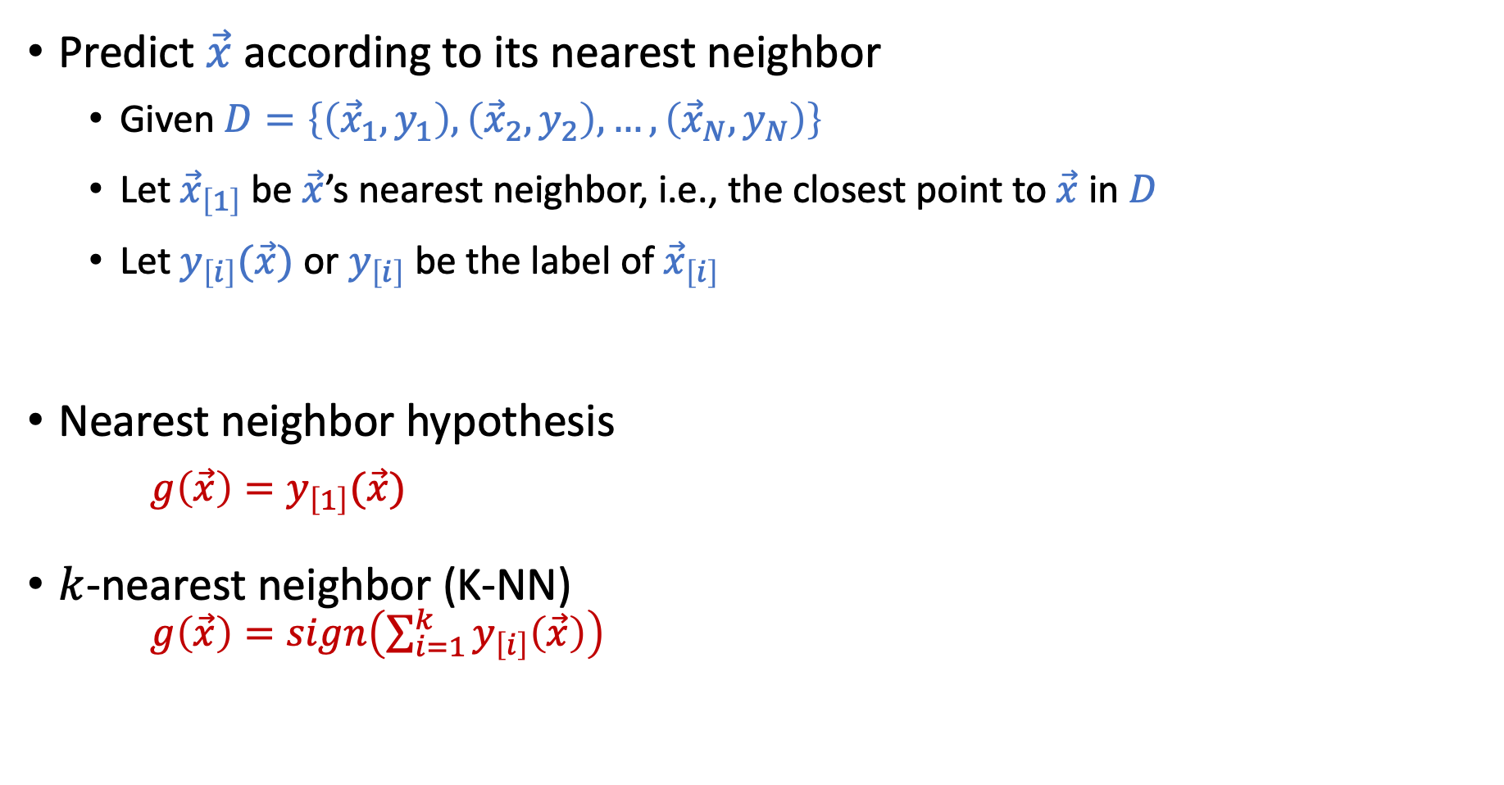
Nearest Neighbors
Predict $\vec{x}$ according to its nearest neighbor
Given $D=\left\{\left({\vec{x}}_{1},y_{1}\right),\left({\vec{x}}_{2},y_{2}\right),…,\left({\vec{x}}_{N},y_{N}\right)\right\}$
Let ${\vec{x}}_{\left[1\right]}$ be $\vec{x}$’s nearest neighbor, i.e., the closest point to $\vec{x}$ in $D$
Let $y_{\left[i\right]}(\vec{x})$ or $y_{\left[i\right]}$ be the label of ${\vec{x}}_{\left[i\right]}$
Nearest neighbor hypothesis $g\left(\vec{x}\right)=y_{\left[1\right]}(\vec{x})$
$k$-nearest neighbor (K-NN) $g\left(\vec{x}\right)=sign\left(\sum_{i=1}^{k}{y_{\left[i\right]}\left(\vec{x}\right)}\right)$

Slide 15
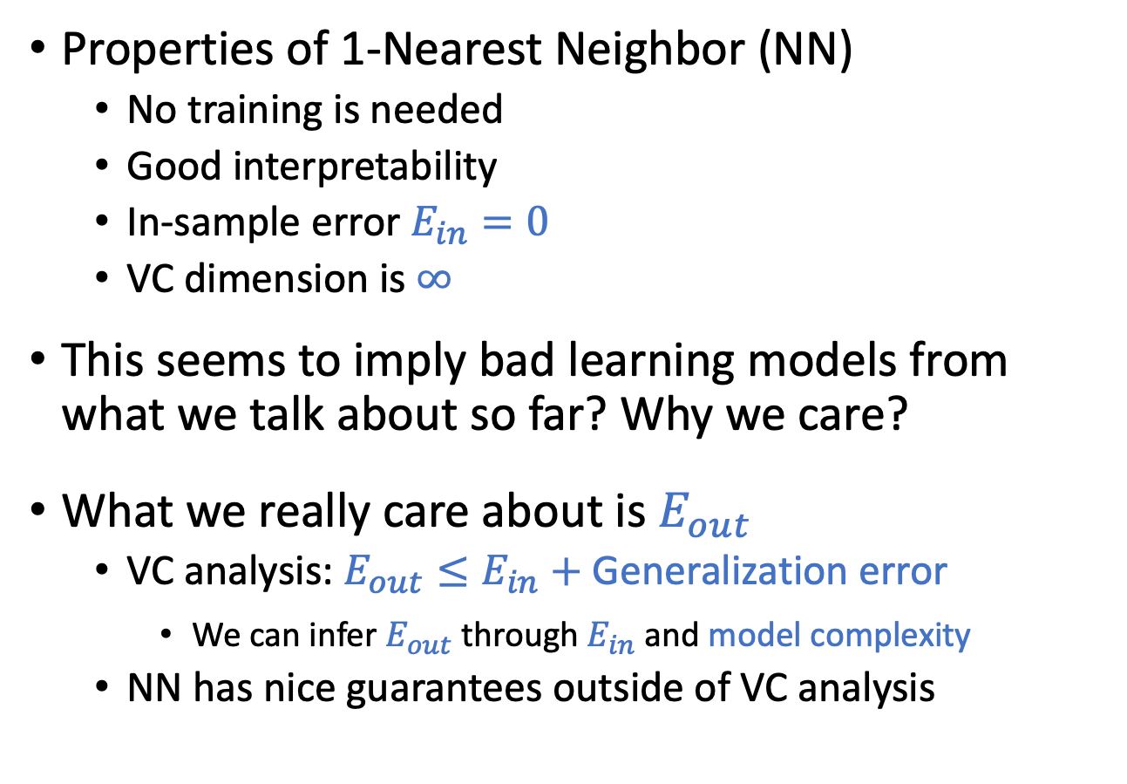
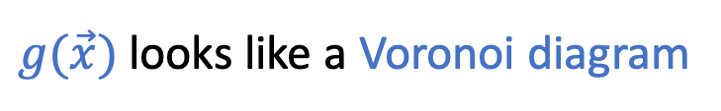
1-Nearest Neighbor
Properties of 1-Nearest Neighbor (NN)
No training is needed
Good interpretability
In-sample error $E_{in}=0$
VC dimension is $∞$
This seems to imply bad learning models from what we talk about so far? Why we care?
What we really care about is $E_{out}$
VC analysis: $E_{out}≤E_{in}+$ Generalization error
We can infer $E_{out}$ through $E_{in}$ and model complexity
NN has nice guarantees outside of VC analysis
$g(\vec{x})$ looks like a Voronoi diagram

Slide 16
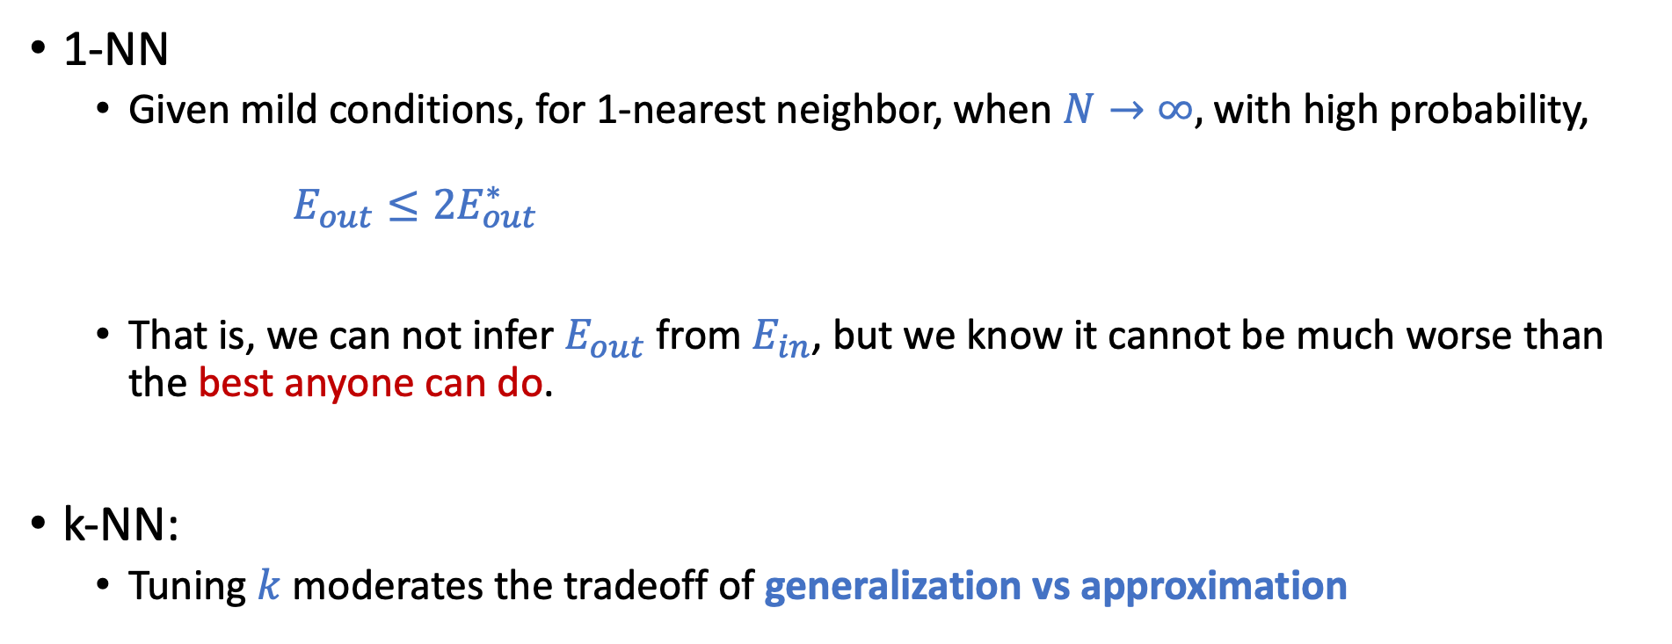
Properties of Nearest Neighbors
1-NN
Given mild conditions, for 1-nearest neighbor, when $N→∞,$ with high probability, $E_{out}≤2E_{out}^{∗}$
That is, we can not infer $E_{out}$ from $E_{in}$, but we know it cannot be much worse than the best anyone can do.
k-NN:
Tuning $k$ moderates the tradeoff of generalization vs approximation

Slide 17
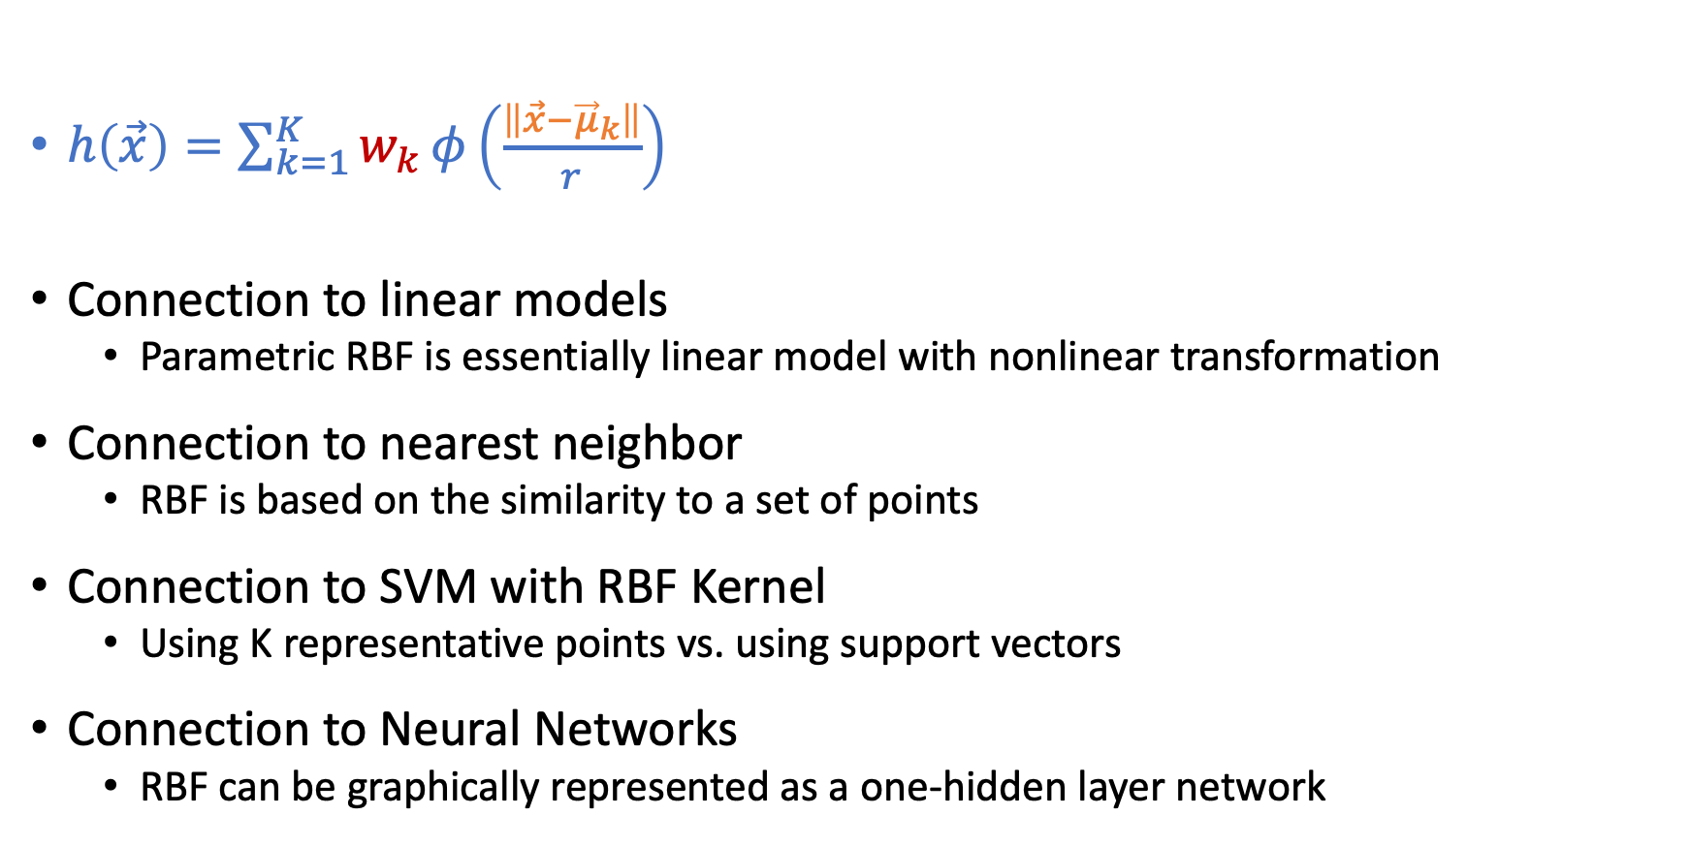
Radial Basis Function
$h\left(\vec{x}\right)=\sum_{k=1}^{K}{w_{k}}φ\left(\frac{\left\|\vec{x}−{\vec{μ}}_{k}\right\|}{r}\right)$
Connection to linear models
Parametric RBF is essentially linear model with nonlinear transformation
Connection to nearest neighbor
RBF is based on the similarity to a set of points
Connection to SVM with RBF Kernel
Using K representative points vs. using support vectors
Connection to Neural Networks
RBF can be graphically represented as a one-hidden layer network

Slide 18
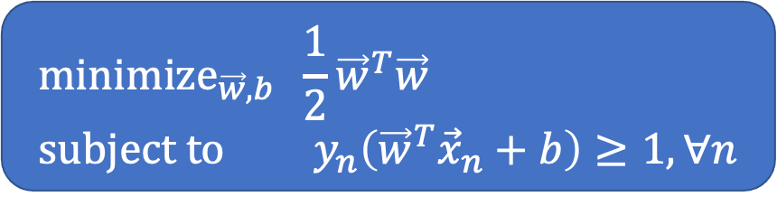
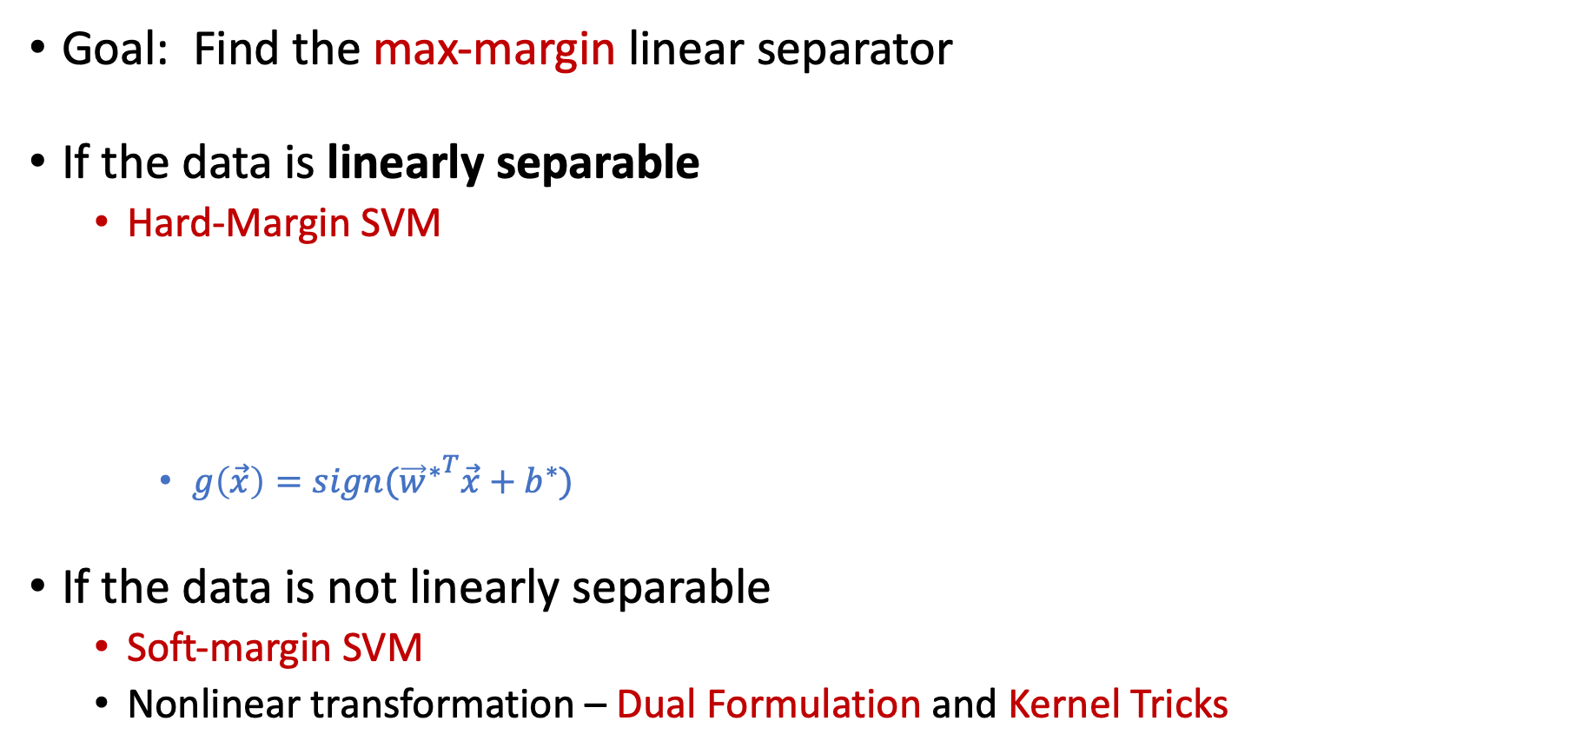
Support Vector Machines
Goal: Find the max-margin linear separator
If the data is linearly separable
Hard-Margin SVM
$g\left(\vec{x}\right)=sign({{\vec{w}}^{∗}}^{T}\vec{x}+b^{∗})$
If the data is not linearly separable
Soft-margin SVM
Nonlinear transformation – Dual Formulation and Kernel Tricks
Margin
$${\text{minimize}}_{\vec{w},b} \frac{1}{2}{\vec{w}}^{T}\vec{w} \\ \text{subject} \text{to} y_{n}\left({\vec{w}}^{T}{\vec{x}}_{n}+b\right)≥1, ∀n$$

Slide 19
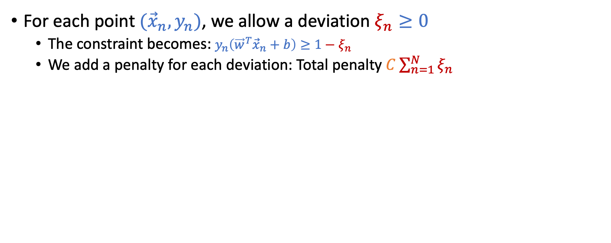
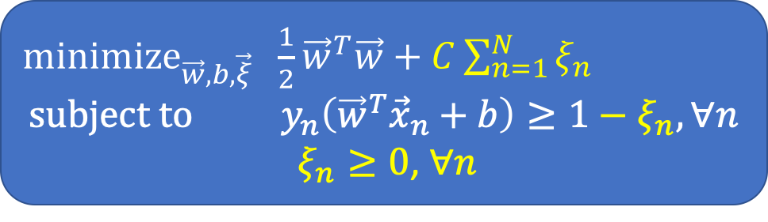
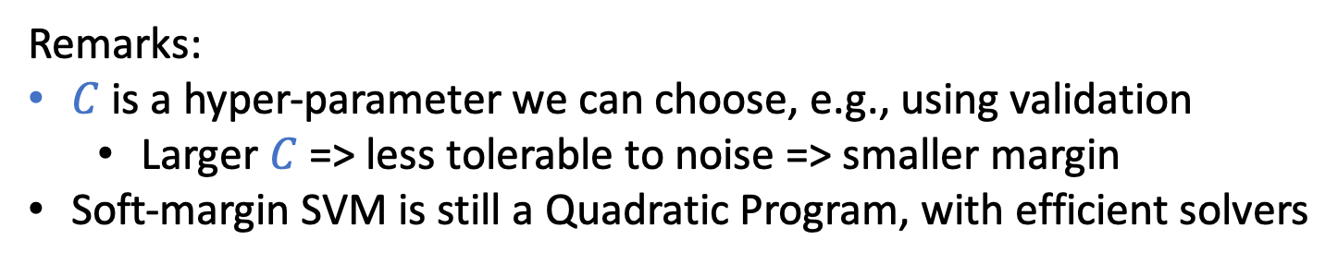
Soft-Margin SVM
For each point $({\vec{x}}_{n},y_{n})$, we allow a deviation $ξ_{n}≥0$
The constraint becomes: $y_{n}\left({\vec{w}}^{T}{\vec{x}}_{n}+b\right)≥1−ξ_{n}$
We add a penalty for each deviation: Total penalty $C\sum_{n=1}^{N}{ξ_{n}}$
${\text{minimize}}_{\vec{w},b,\vec{ξ}} \frac{1}{2}{\vec{w}}^{T}\vec{w}+C\sum_{n=1}^{N}{ξ_{n}}$ $$\text{subject} \text{to} y_{n}\left({\vec{w}}^{T}{\vec{x}}_{n}+b\right)≥1−ξ_{n}, ∀n$$
$ξ_{n}≥0$, $∀n$
Remarks:
$C$ is a hyper-parameter we can choose, e.g., using validation
Larger $C$ => less tolerable to noise => smaller margin
Soft-margin SVM is still a Quadratic Program, with efficient solvers

Slide 20
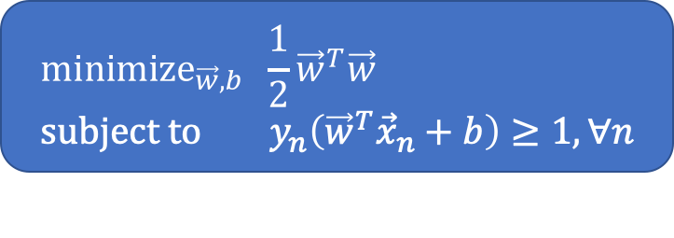
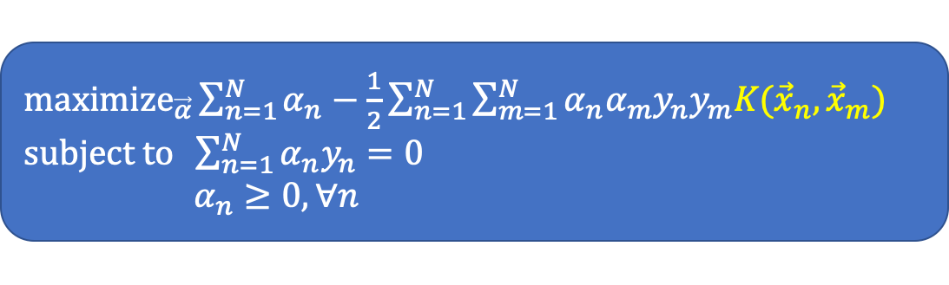
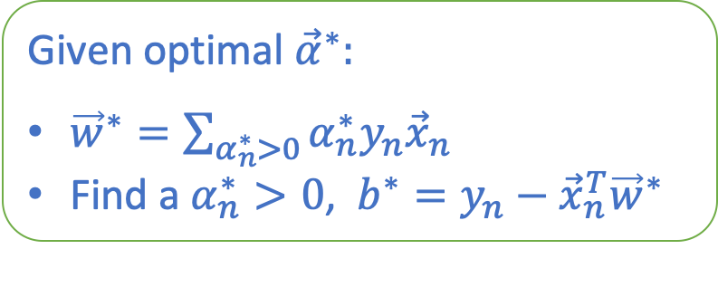
Primal-Dual Formulations of Hard-Margin SVM
Primal
Dual + Kernel Trick
Both can be efficiently solved using QP solver.
We can infer the solution from one to the other
Given optimal ${\vec{α}}^{∗}:$
${\vec{w}}^{∗}=\sum_{α_{n}^{∗}>0}{α_{n}^{∗}y_{n}{\vec{x}}_{n}}$
Find a $α_{n}^{∗}>0$, $b^{∗}=y_{n}−{\vec{x}}_{n}^{T}{\vec{w}}^{∗}$
$${\text{minimize}}_{\vec{w},b} \frac{1}{2}{\vec{w}}^{T}\vec{w} \\ \text{subject} \text{to} y_{n}\left({\vec{w}}^{T}{\vec{x}}_{n}+b\right)≥1, ∀n$$
${\text{maximize}}_{\vec{α}}\sum_{n=1}^{N}{α_{n}}−\frac{1}{2}\sum_{n=1}^{N}{\sum_{m=1}^{N}{α_{n}α_{m}y_{n}y_{m}K({\vec{x}}_{n},{\vec{x}}_{m})}}$ $\text{subject} \text{to} \sum_{n=1}^{N}{α_{n}y_{n}=0}$ $α_{n}≥0,∀n$

Slide 21
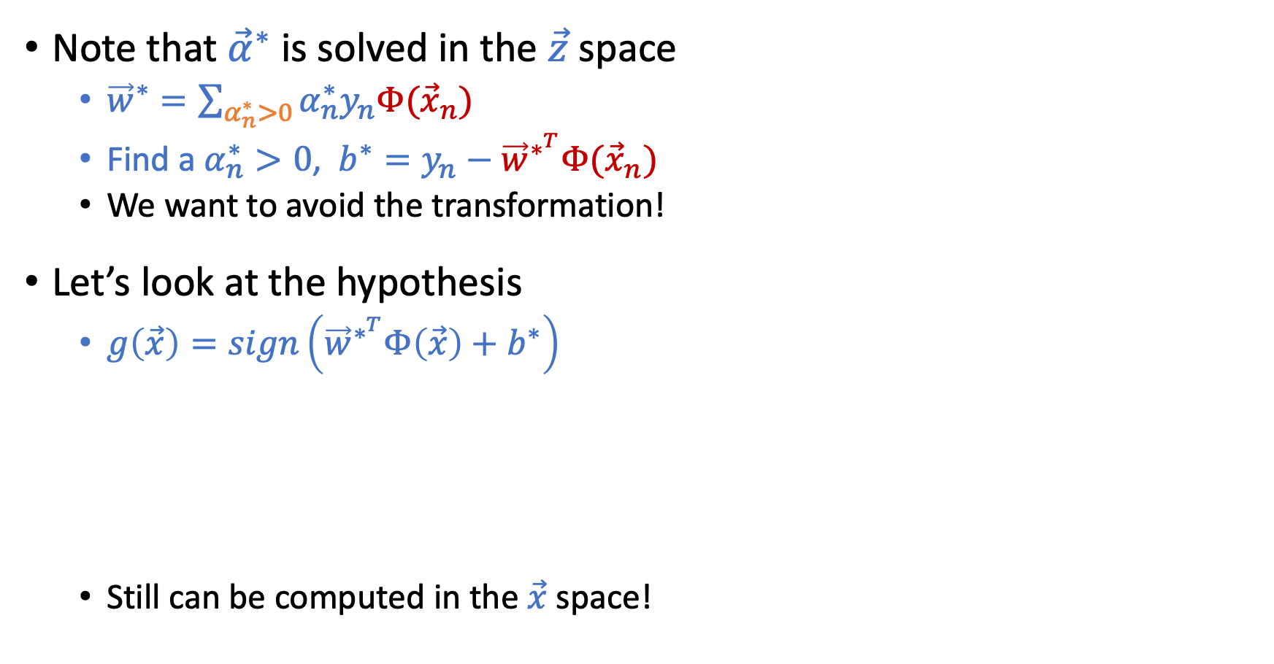
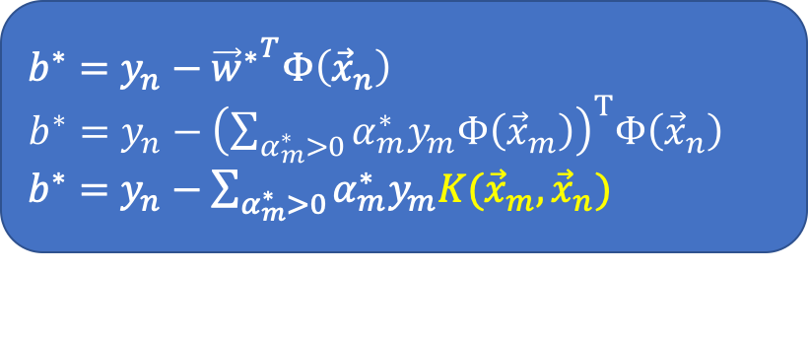
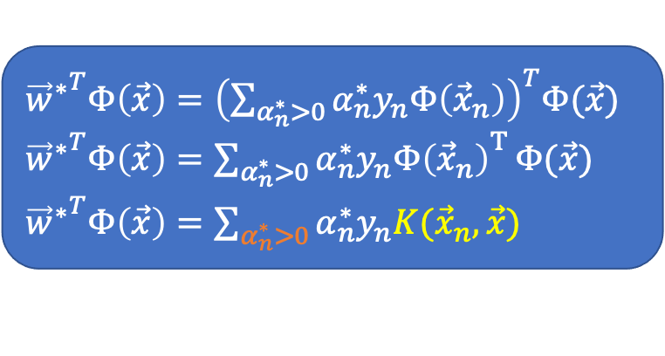
Recover $({\vec{w}}^{∗},b^{∗})$ from ${\vec{α}}^{∗}$ with Kernel Tricks
Note that ${\vec{α}}^{∗}$ is solved in the $\vec{z}$ space
${\vec{w}}^{∗}=\sum_{α_{n}^{∗}>0}{α_{n}^{∗}y_{n}Φ({\vec{x}}_{n})}$
Find a $α_{n}^{∗}>0$, $b^{∗}=y_{n}−{\vec{w}}^{∗^{T}}Φ({\vec{x}}_{n})$
We want to avoid the transformation!
Let’s look at the hypothesis
$g\left(\vec{x}\right)=sign\left({\vec{w}}^{∗^{T}}Φ\left(\vec{x}\right)+b^{∗}\right)$
Still can be computed in the $\vec{x}$ space!
${{\vec{w}}^{∗}}^{T}Φ\left(\vec{x}\right)={\left(\sum_{α_{n}^{∗}>0}{α_{n}^{∗}y_{n}Φ\left({\vec{x}}_{n}\right)}\right)}^{T}Φ(\vec{x})$
${{\vec{w}}^{∗}}^{T}Φ\left(\vec{x}\right)={\sum_{α_{n}^{∗}>0}{α_{n}^{∗}y_{n}Φ\left({\vec{x}}_{n}\right)}}^{T}Φ(\vec{x})$
${{\vec{w}}^{∗}}^{T}Φ\left(\vec{x}\right)={\sum_{α_{n}^{∗}>0}{α_{n}^{∗}y_{n}K({\vec{x}}_{n},\vec{x})}}^{}$
$b^{∗}=y_{n}−{{\vec{w}}^{∗}}^{T}Φ\left({\vec{x}}_{n}\right)$
$b^{∗}=y_{n}−{\left(\sum_{α_{m}^{∗}>0}{α_{m}^{∗}y_{m}Φ\left({\vec{x}}_{m}\right)}\right)}^{T}Φ\left({\vec{x}}_{n}\right)$
$b^{∗}=y_{n}−\sum_{α_{m}^{∗}>0}{α_{m}^{∗}y_{m}K({\vec{x}}_{m},{\vec{x}}_{n})}$

Slide 22
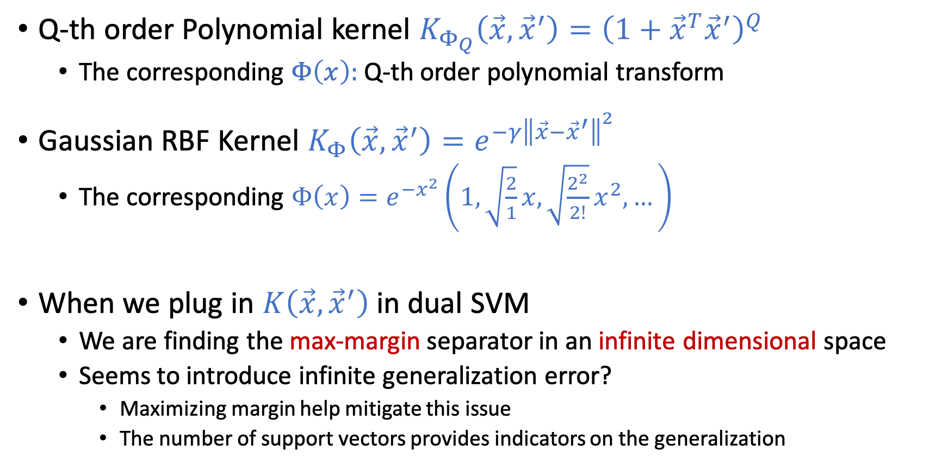
Kernel Functions
Q-th order Polynomial kernel $K_{Φ_{Q}}\left(\vec{x},{\vec{x}}^{′}\right)={\left(1+{\vec{x}}^{T}{\vec{x}}^{′}\right)}^{Q}$
The corresponding $Φ\left(x\right):$ Q-th order polynomial transform
Gaussian RBF Kernel $K_{Φ}\left(\vec{x},{\vec{x}}^{′}\right)=e^{−γ{\left\|\vec{x}−{\vec{x}}^{′}\right\|}^{2}}{ }$
The corresponding $Φ\left(x\right)=e^{−x^{2}}\left(1,\sqrt{\frac{2}{1}}x,\sqrt{\frac{2^{2}}{2!}}x^{2},…\right)$
When we plug in $K\left(\vec{x},{\vec{x}}^{′}\right)$ in dual SVM
We are finding the max-margin separator in an infinite dimensional space
Seems to introduce infinite generalization error?
Maximizing margin help mitigate this issue
The number of support vectors provides indicators on the generalization

Slide 23
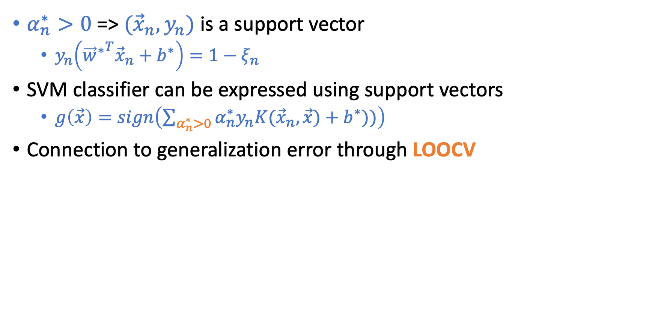

Support Vectors
$α_{n}^{∗}>0$ => $({\vec{x}}_{n},y_{n})$ is a support vector
$y_{n}\left({{\vec{w}}^{∗}}^{T}{\vec{x}}_{n}+b^{∗}\right)=1−ξ_{n}$
SVM classifier can be expressed using support vectors
$g\left(\vec{x}\right)=sign\left(\sum_{α_{n}^{∗}>0}{α_{n}^{∗}y_{n}K({\vec{x}}_{n},\vec{x})}+b^{∗}))\right)$
Connection to generalization error through LOOCV
$$E_{LOOCV}≤\frac{\# \text{support} \text{vectors}}{N}$$

Slide 24
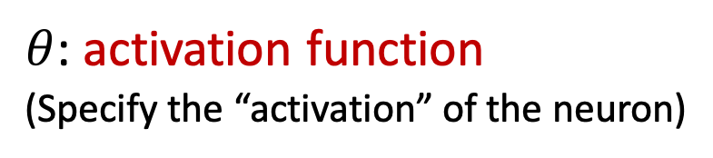
Neural Networks
$θ$: activation function
(Specify the “activation” of the neuron)
We mostly focus on feed-forward network structure

Slide 25
Notations of Neural Networks (NN)
Notations:
$ℓ=0$ to $L$: layer
$d^{(ℓ)}$: dimension of layer $ℓ$
${\vec{x}}^{(ℓ)}:$ the nodes in layer $ℓ$
$w_{i,j}^{(ℓ)}$: weights; characterize hypothesis in NN
$s_{j}^{ (ℓ)}=\sum_{i=0}^{d^{(ℓ−1)}}{w_{i,j}^{(ℓ)}x_{i}^{(ℓ−1)}}$: linear signals
$θ$: activation function
$x_{j}^{(ℓ)}=θ\left(s_{j}^{\left(ℓ\right) }\right)$
Notes:
4x2 + 3x1 = 11

Slide 26

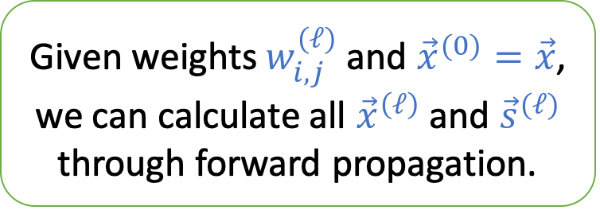
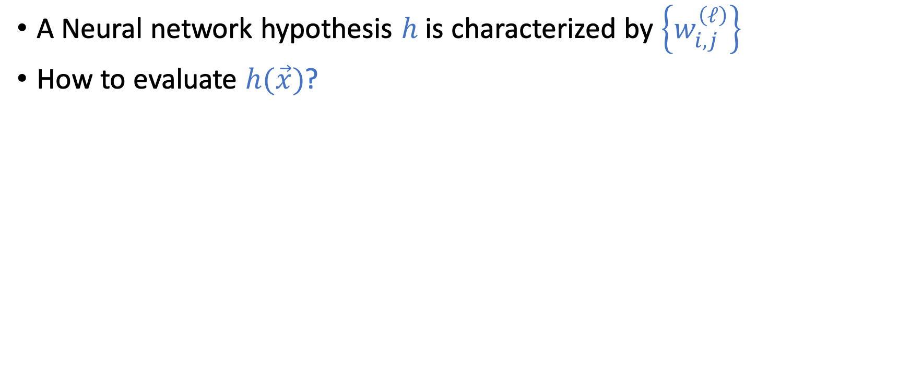
Forward Propagation (evaluate $h(\vec{x})$)
A Neural network hypothesis $h$ is characterized by $\left\{w_{i,j}^{\left(ℓ\right)}\right\}$
How to evaluate $h(\vec{x})$?
Given weights $w_{i,j}^{(ℓ)}$ and ${\vec{x}}^{(0)}=\vec{x}$, we can calculate all ${\vec{x}}^{\left(ℓ\right)}$ and ${\vec{s}}^{(ℓ)}$ through forward propagation.

Slide 27
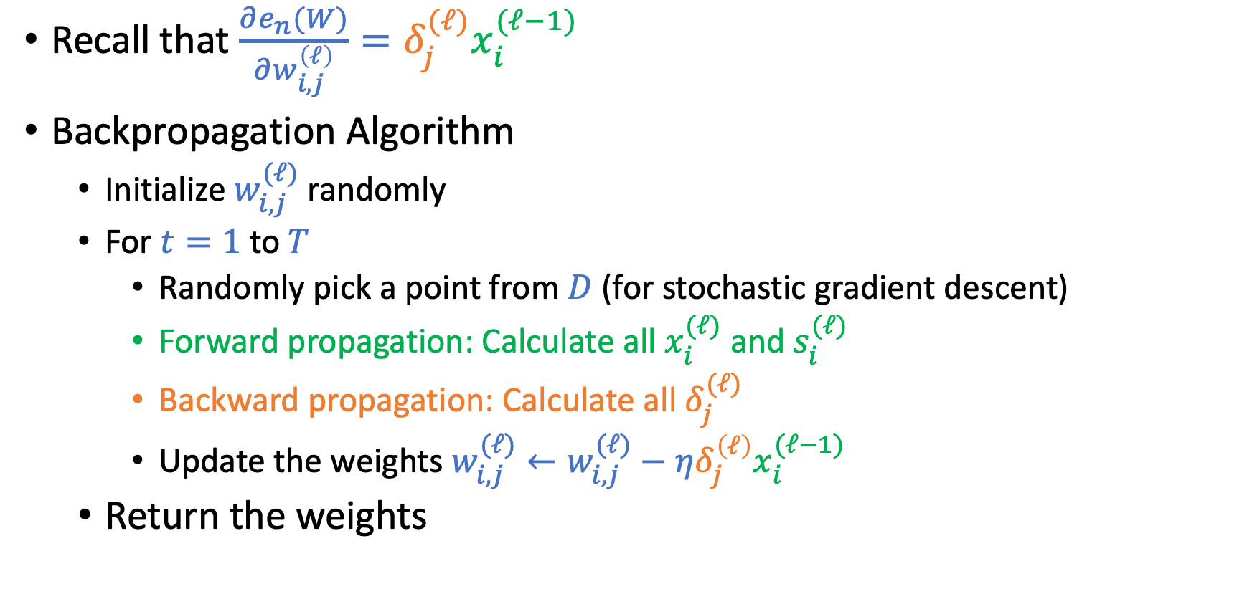
Backpropagation Algorithm
Recall that $\frac{∂e_{n}(W)}{∂w_{i,j}^{\left(ℓ\right)}}=δ_{j}^{(ℓ)}x_{i}^{(ℓ−1)}$
Backpropagation Algorithm
Initialize $w_{i,j}^{(ℓ)}$randomly
For $t=1$ to $T$
Randomly pick a point from $D$ (for stochastic gradient descent)
Forward propagation: Calculate all $x_{i}^{(ℓ)}$ and $s_{i}^{(ℓ)}$
Backward propagation: Calculate all $δ_{j}^{(ℓ)}$
Update the weights $w_{i,j}^{(ℓ)}←w_{i,j}^{(ℓ)}−ηδ_{j}^{\left(ℓ\right)}x_{i}^{(ℓ−1)}$
Return the weights

Slide 28
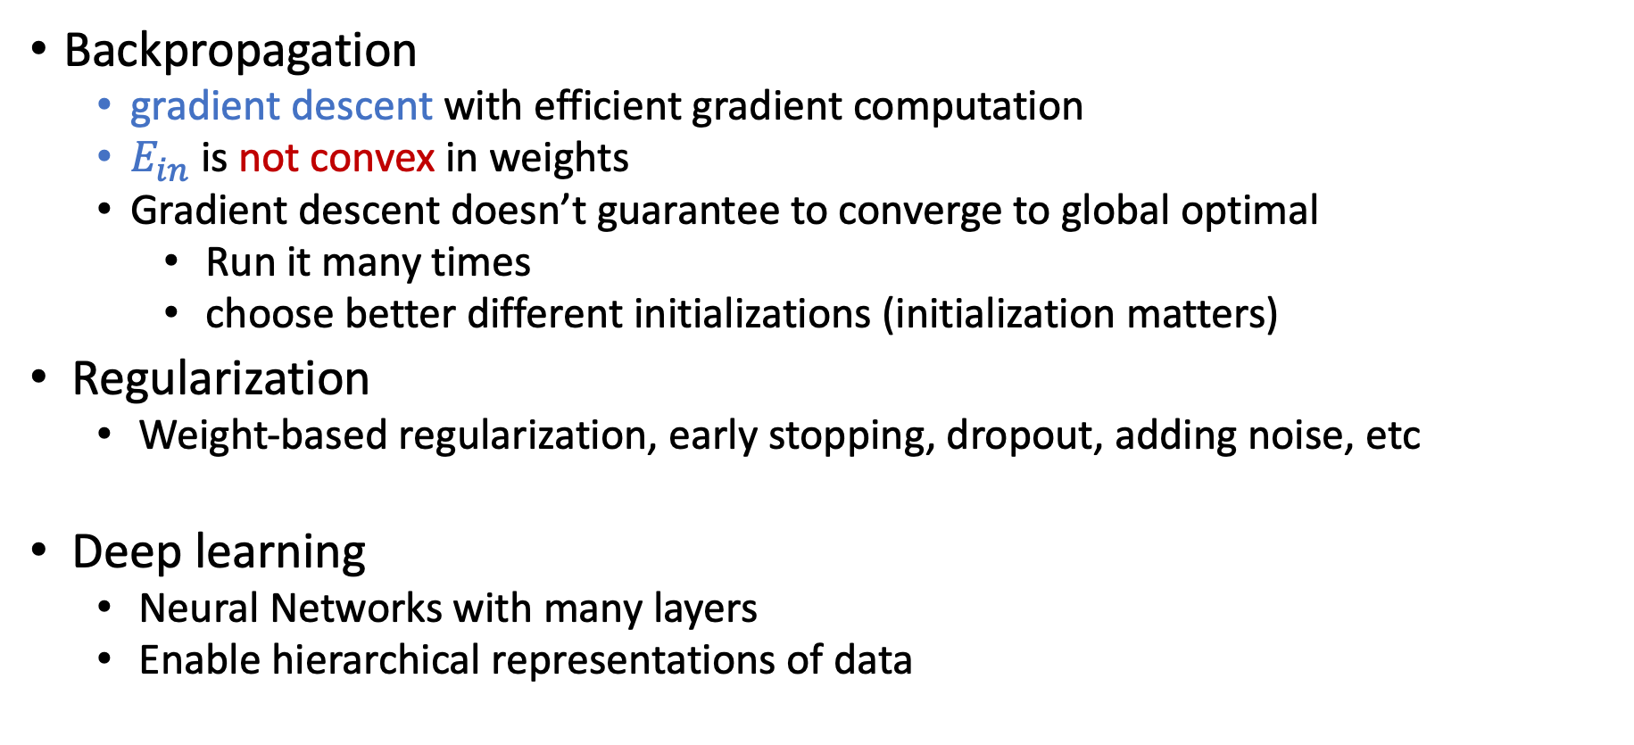
Discussion
Backpropagation
gradient descent with efficient gradient computation
$E_{in}$ is not convex in weights
Gradient descent doesn’t guarantee to converge to global optimal
Run it many times
choose better different initializations (initialization matters)
Regularization
Weight-based regularization, early stopping, dropout, adding noise, etc
Deep learning
Neural Networks with many layers
Enable hierarchical representations of data

Slide 29
Deep Neural Network
“Shallow” neural network is powerful (universal approximation theorem holds with a single hidden layer). Why “deep” neural networks?
Each layer captures features
of the previous layers.
We can use “raw data” (e.g., pixels of an image) as input. The hidden layer are extracting the features.
Design different network architectures to incorporate domain knowledge.

Slide 30
Some Techniques in Improving Deep Learning
Regularization to mitigate overfitting
Weight-based, early stopping, dropout, etc
Incorporating domain knowledges
Network architectures (e.g., Convolutional Neural Nets)
Improving computation with huge amount of data
Hardware architecture to improve parallel computation
Improving gradient-based optimization
Choosing better initialization points

Slide 31
Practice Questions

Slide 32
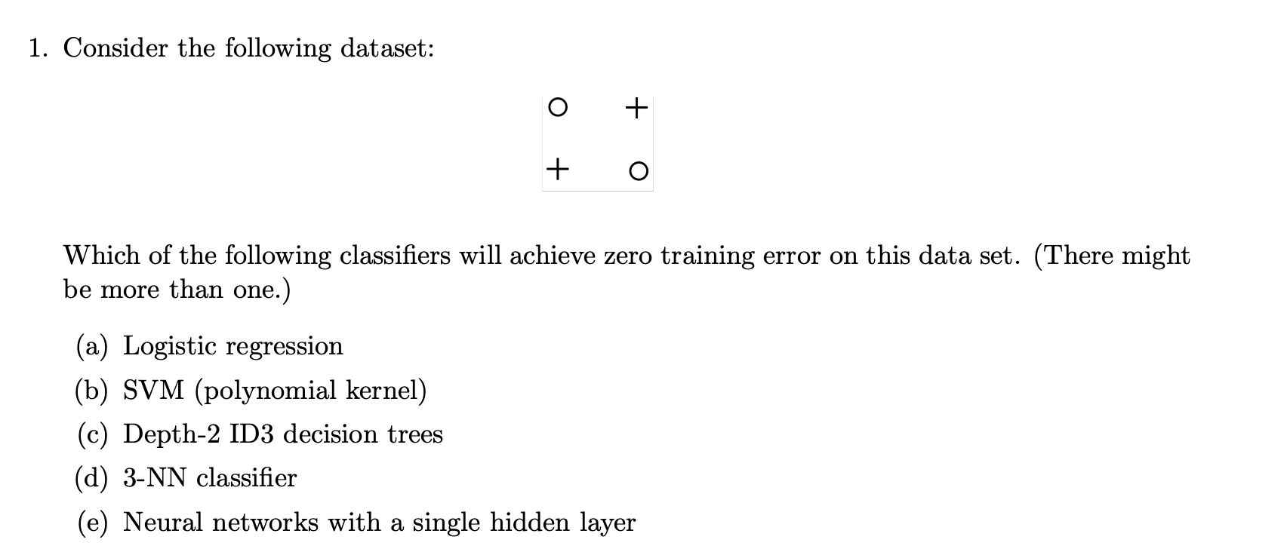

Slide 33
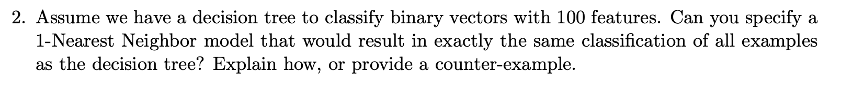
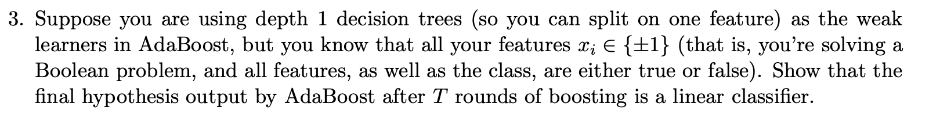

Slide 34
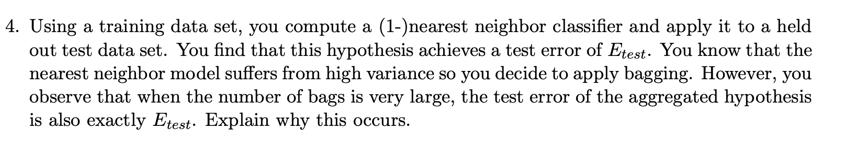

Slide 35
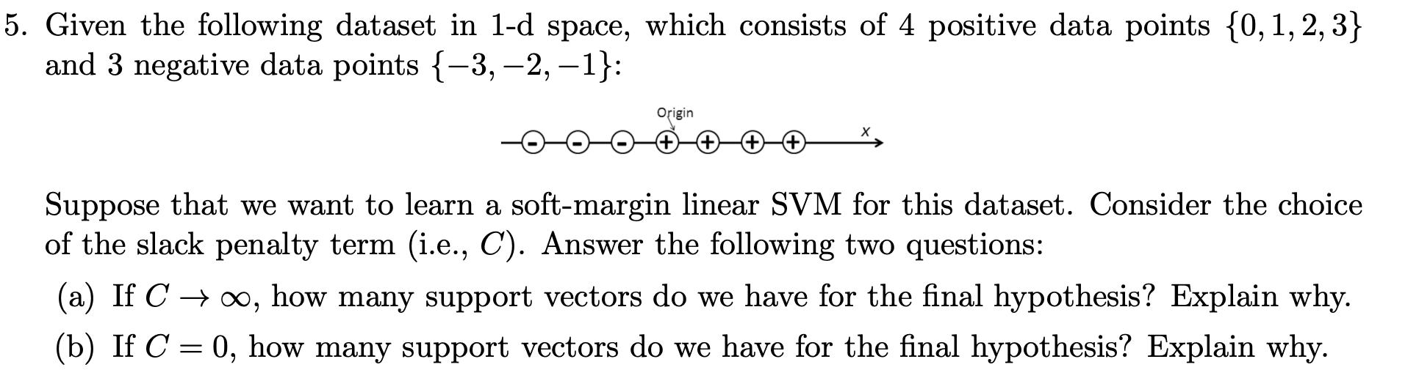
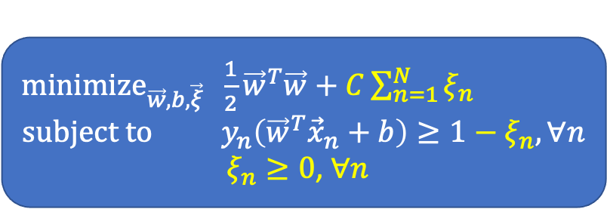
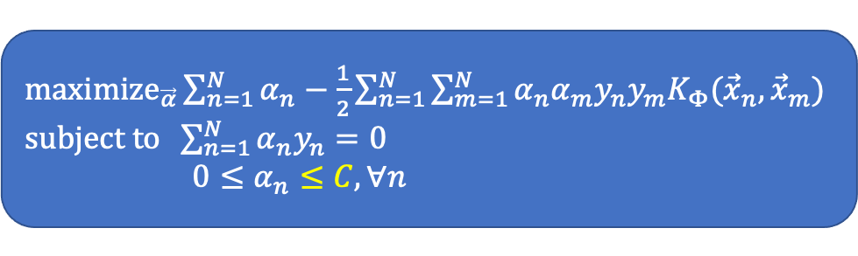
${\text{minimize}}_{\vec{w},b,\vec{ξ}} \frac{1}{2}{\vec{w}}^{T}\vec{w}+C\sum_{n=1}^{N}{ξ_{n}}$ $$\text{subject} \text{to} y_{n}\left({\vec{w}}^{T}{\vec{x}}_{n}+b\right)≥1−ξ_{n}, ∀n$$
$ξ_{n}≥0$, $∀n$
${\text{maximize}}_{\vec{α}}\sum_{n=1}^{N}{α_{n}}−\frac{1}{2}\sum_{n=1}^{N}{\sum_{m=1}^{N}{α_{n}α_{m}y_{n}y_{m}K_{Φ}({\vec{x}}_{n},{\vec{x}}_{m})}}$ $\text{subject} \text{to} \sum_{n=1}^{N}{α_{n}y_{n}=0}$ $0≤α_{n}≤C,∀n$

Slide 36
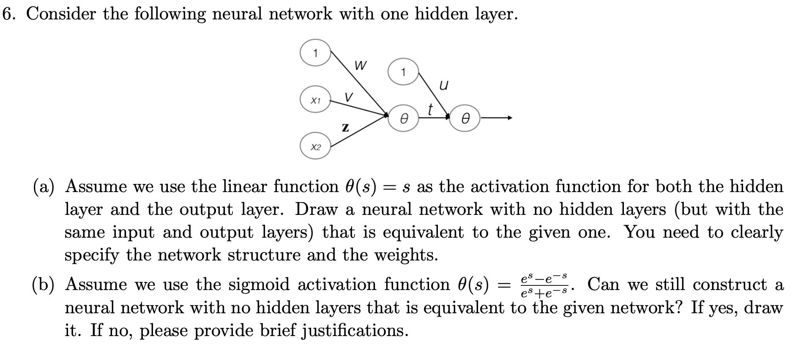

Slide 37
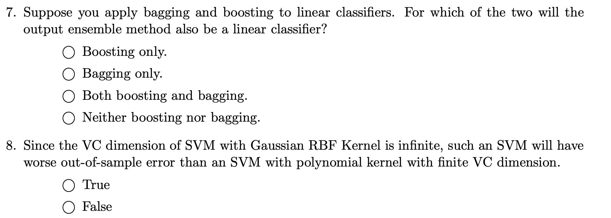

Slide 38
